Slide 1


Cue Cinemas
(Not Vue)

Slide 2
Meet The Team
Adil Akbarali
Kiera Hegarty
Conor Kelly
Jamie Orr
Tayab Khan

Slide 3
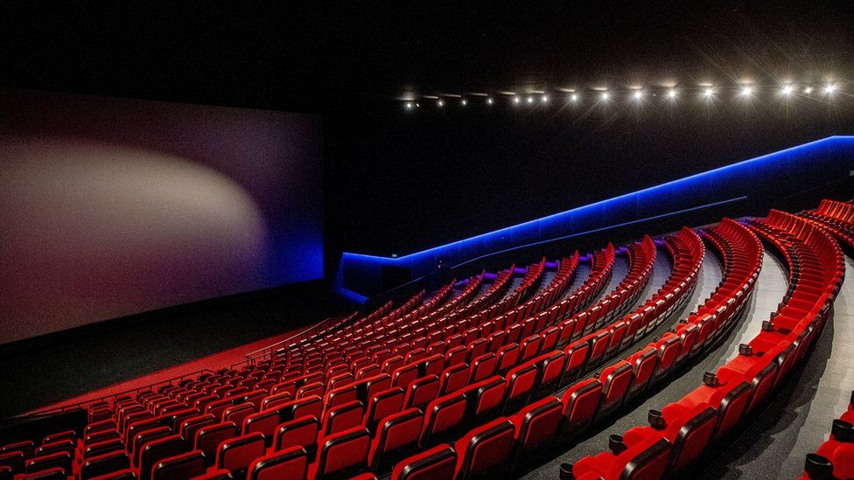


The Pages
Home Page
About Us
Contact Us
Opening Times
Screens
New Releases
Upcoming Releases
Ticket Bookings
Classification
Find Us
Places to Go
Discussion Board

Slide 4

Home Page
Carousel

Slide 5
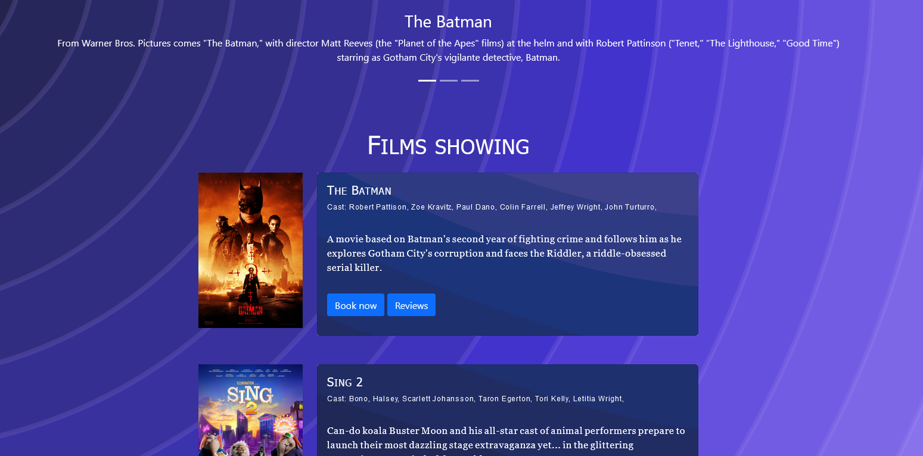
Home Page
Buttons to discussion forum and booking form
Movies List

Slide 6

About Us
Cards

Slide 7
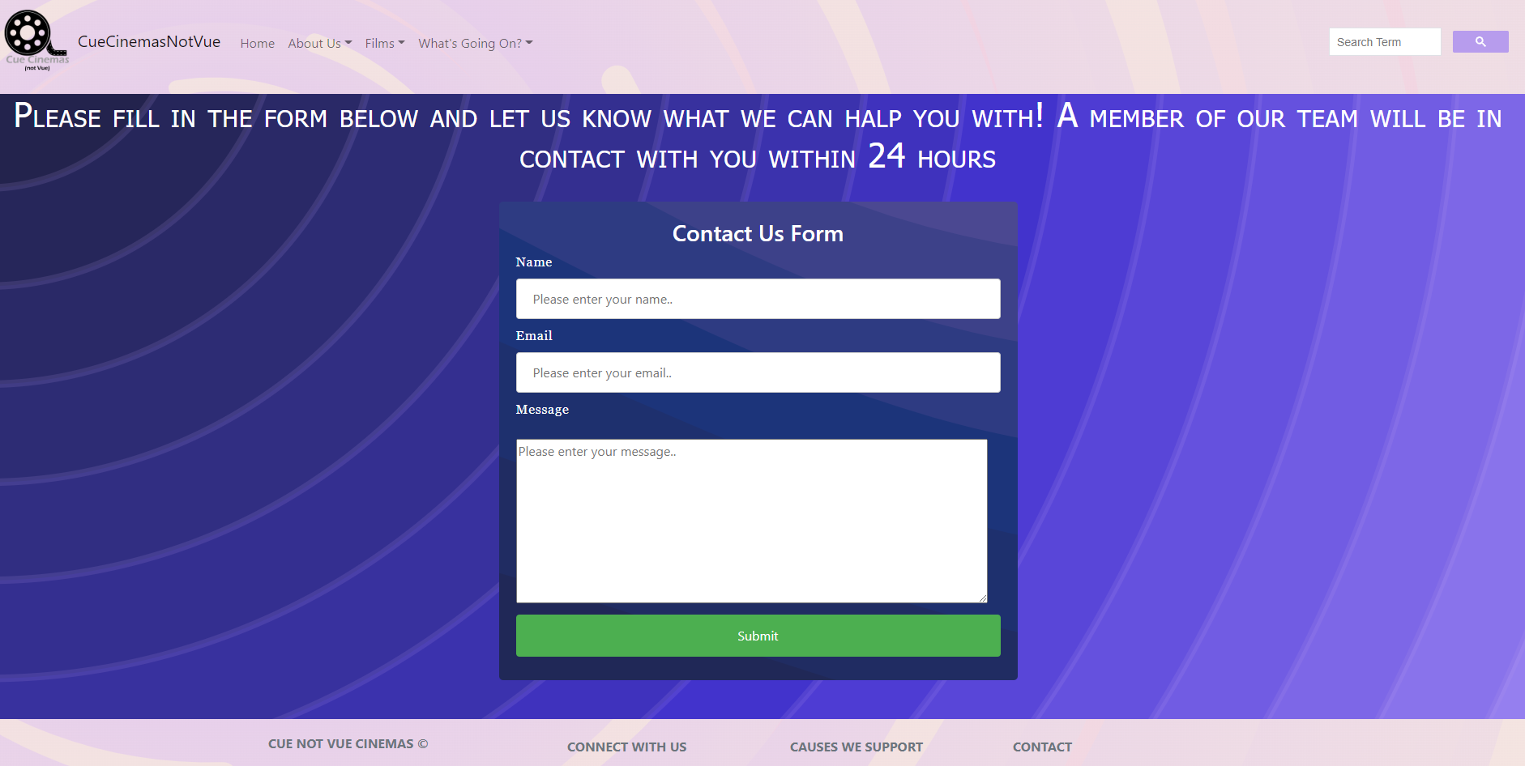
Contact Us Form
Submit Button

Slide 8

Opening Times

Slide 9
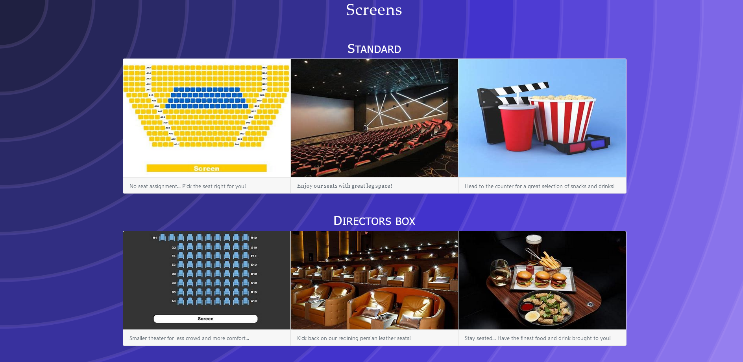
Screens
Both Screen Types taken care of

Slide 10
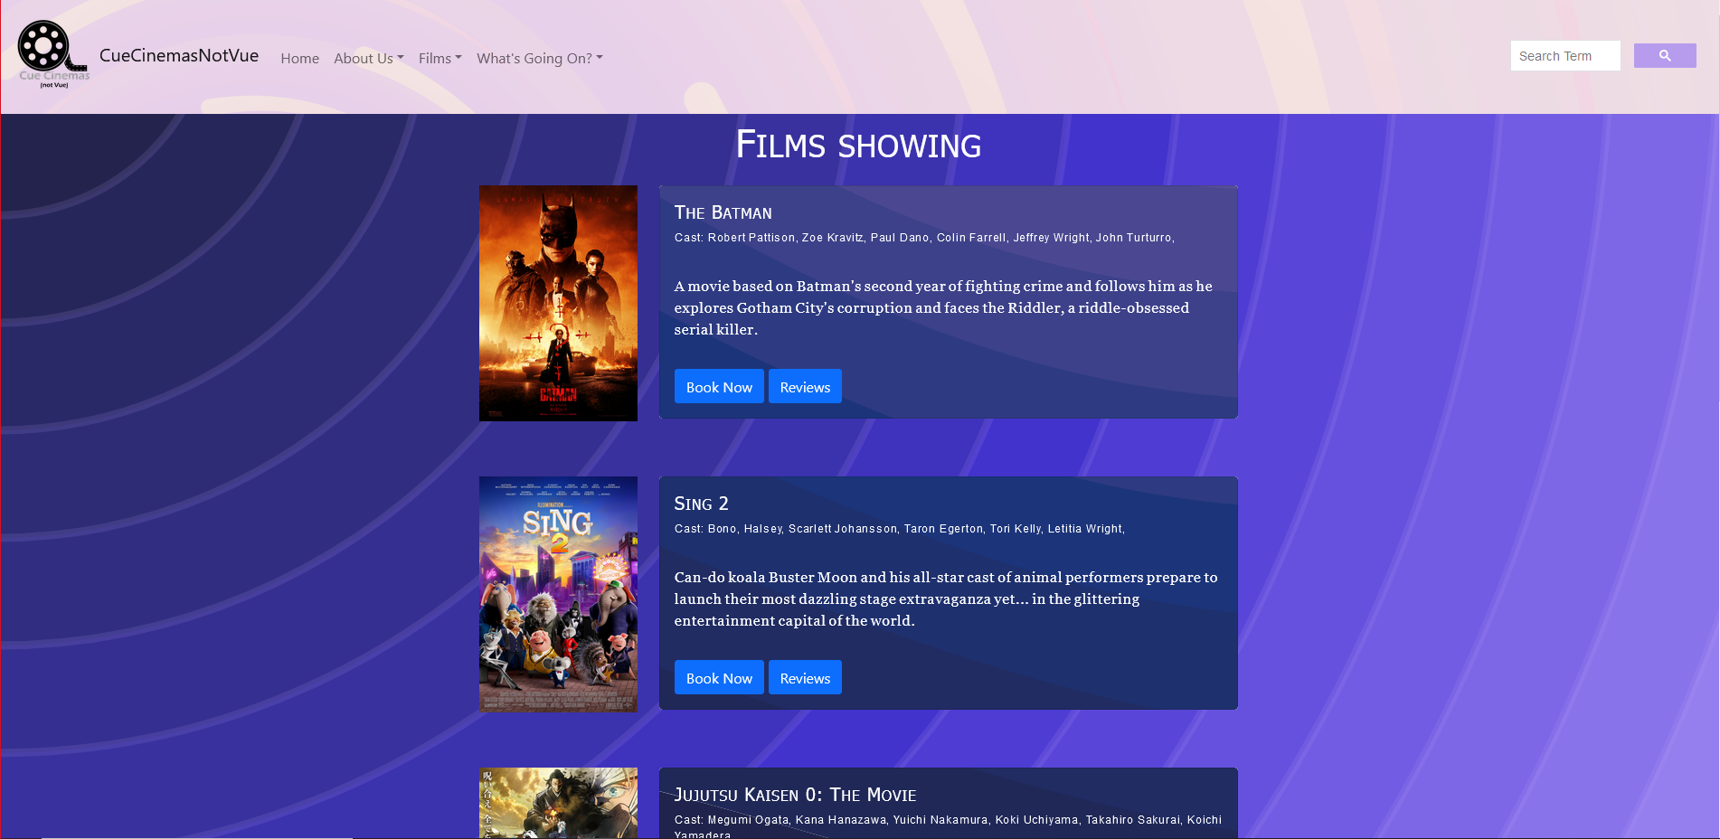
New Releases
Link to Booking page
Link to forum discussion page

Slide 11

Upcoming Releases
Release Date:

Slide 12
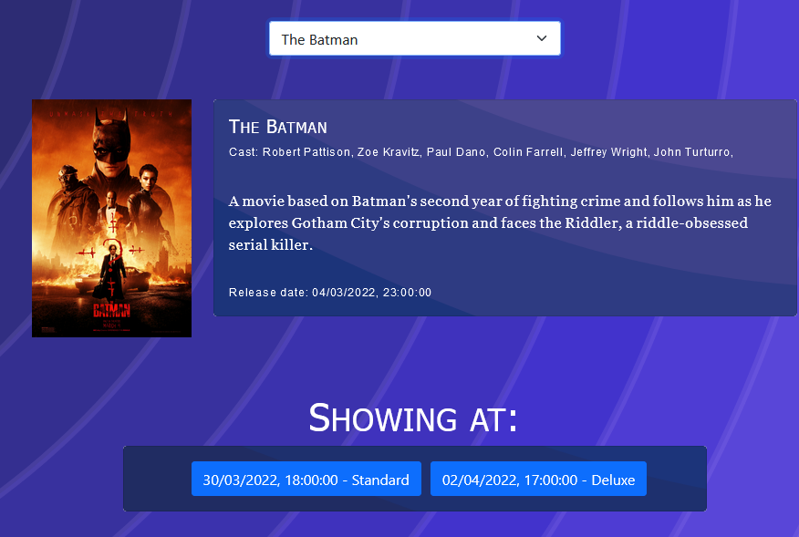
Bookings Page

Slide 13
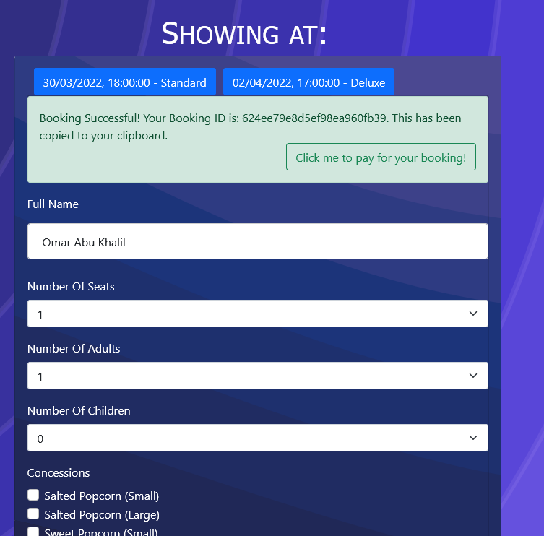
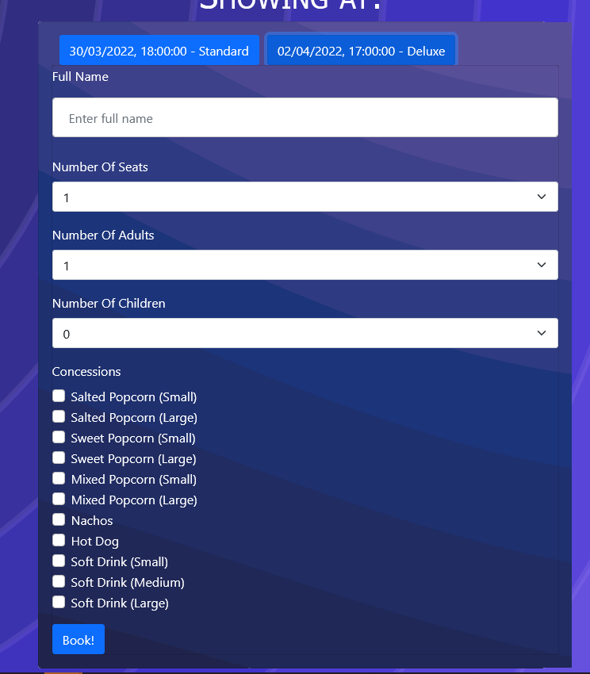
Bookings Page

Slide 14
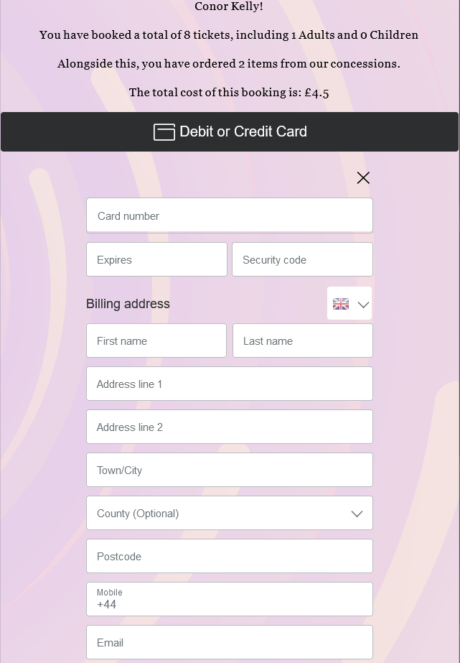
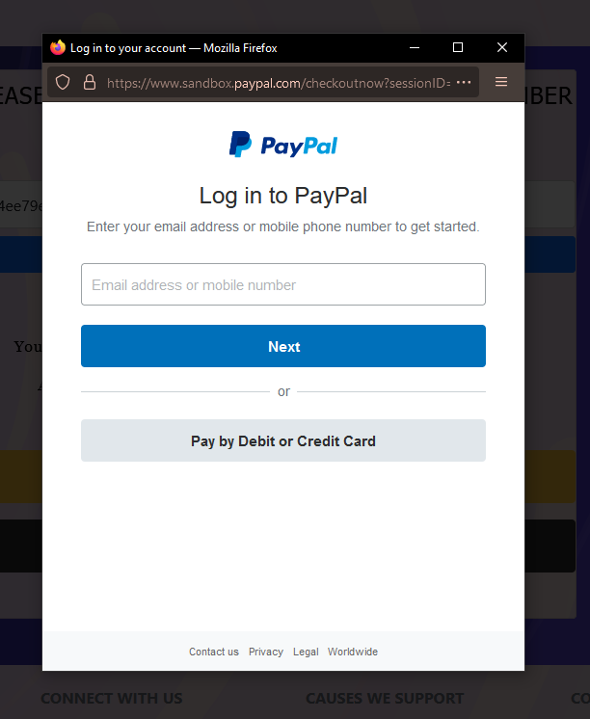
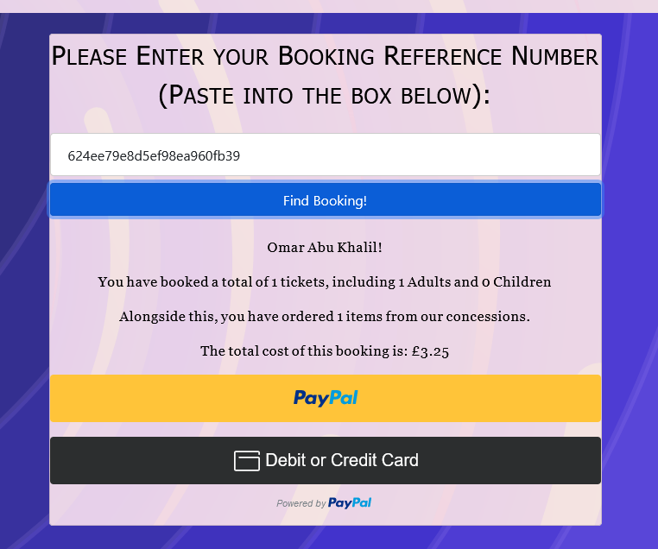
Payments Page

Slide 15
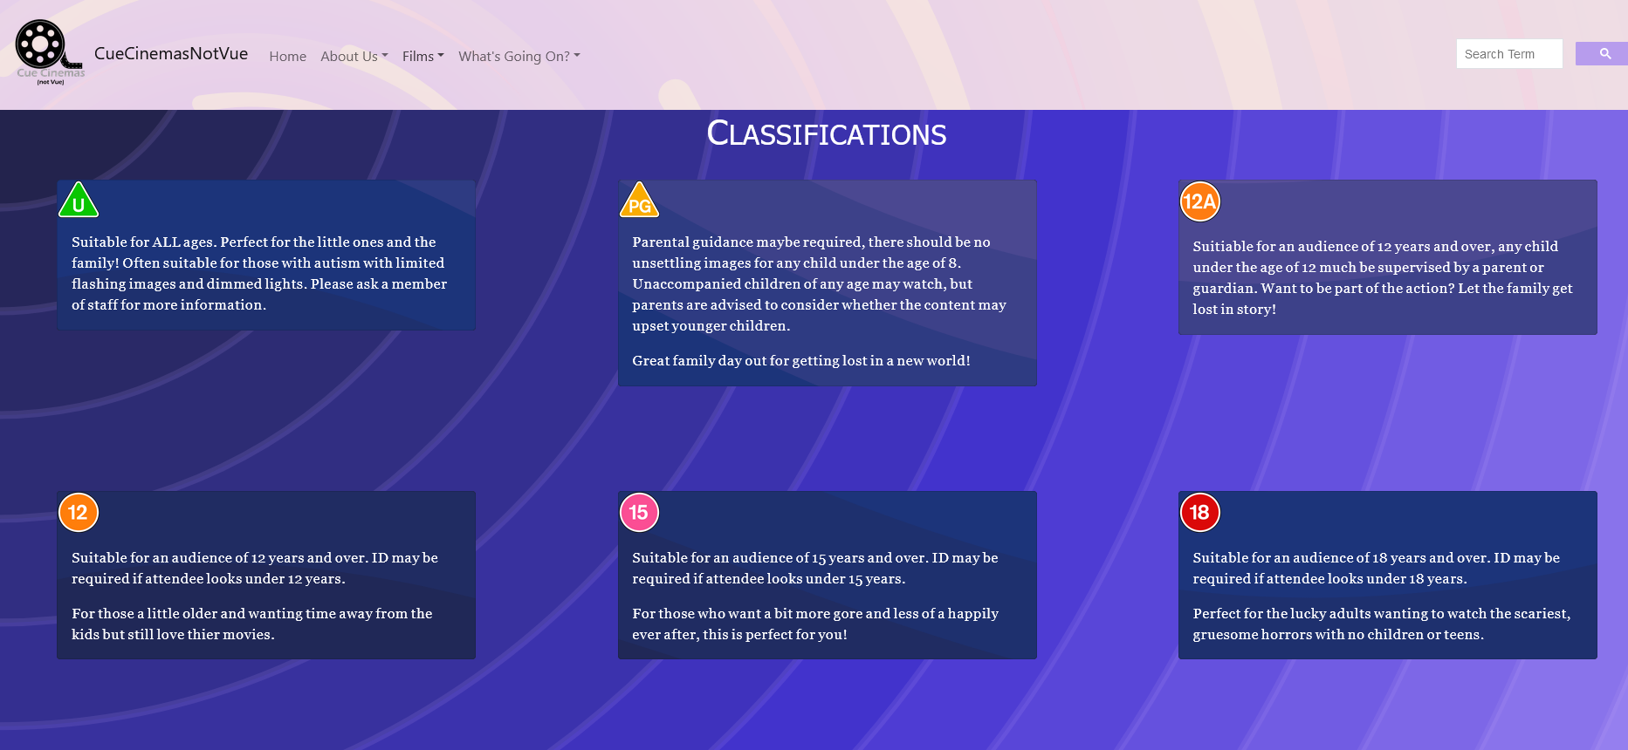
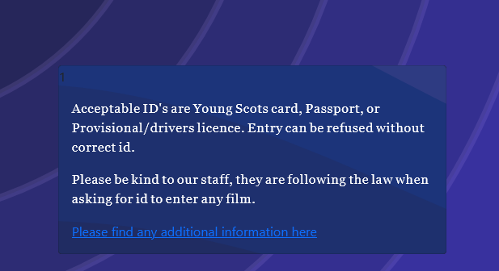
Classification

Slide 16
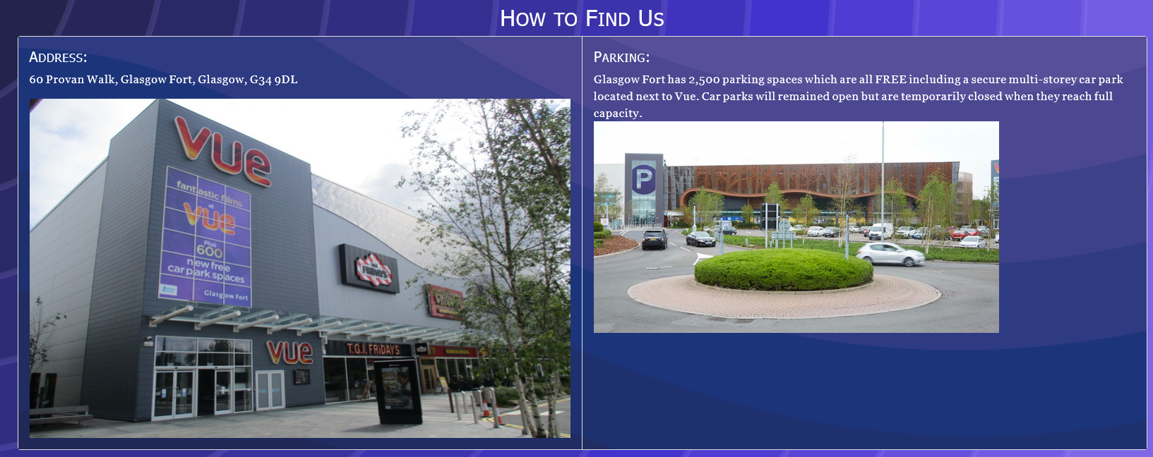
Where To Find Us

Slide 17
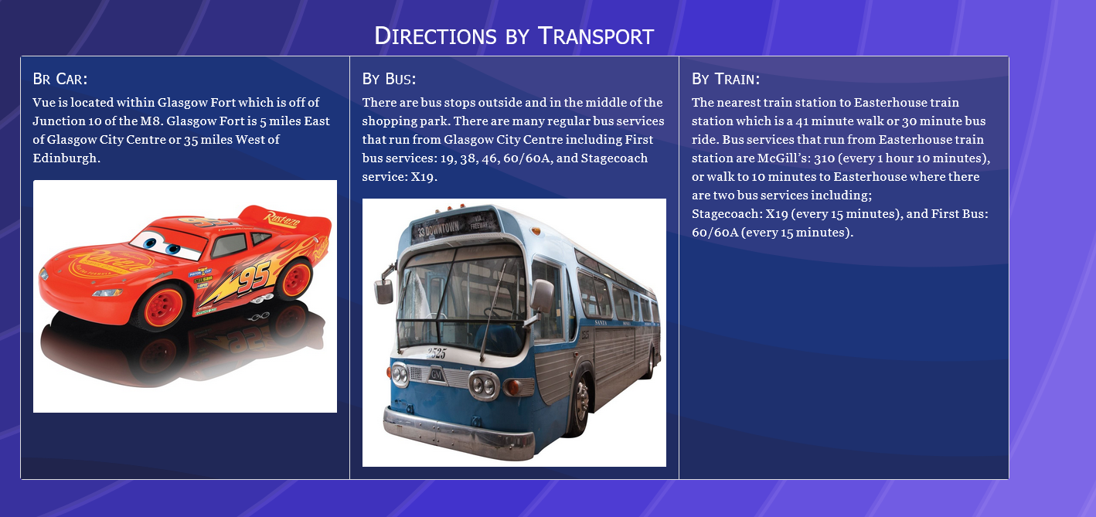
Where To Find Us

Slide 18
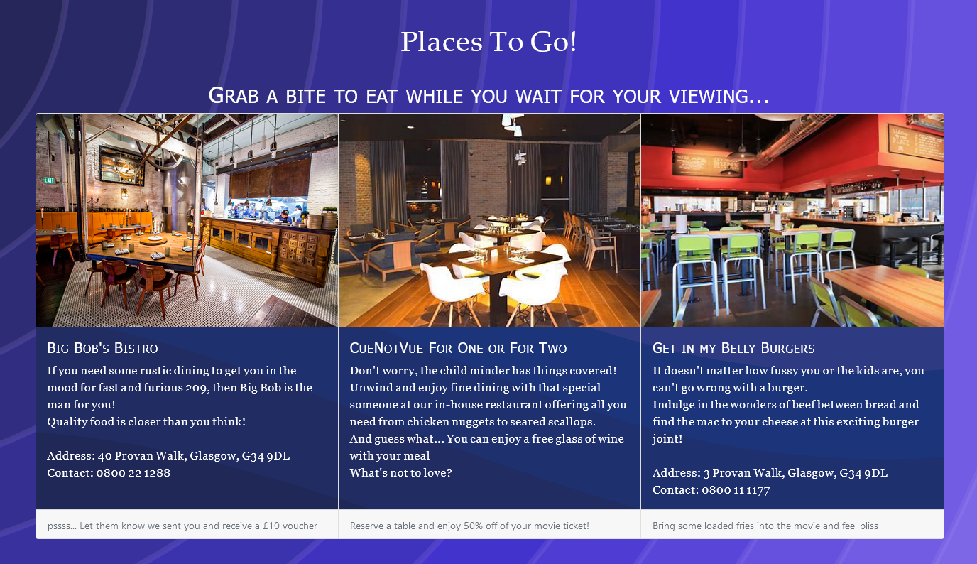
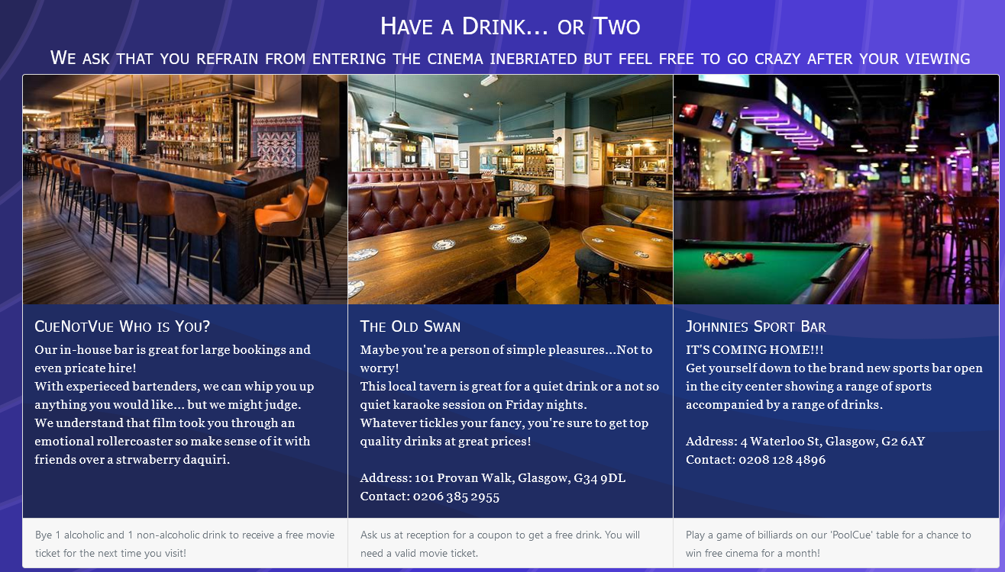
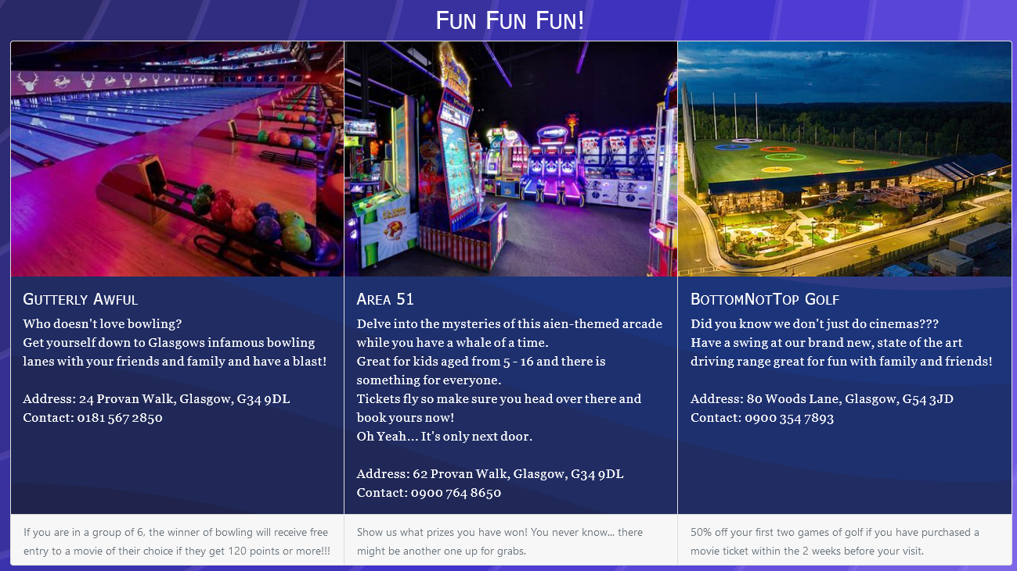
Places To Go

Slide 19
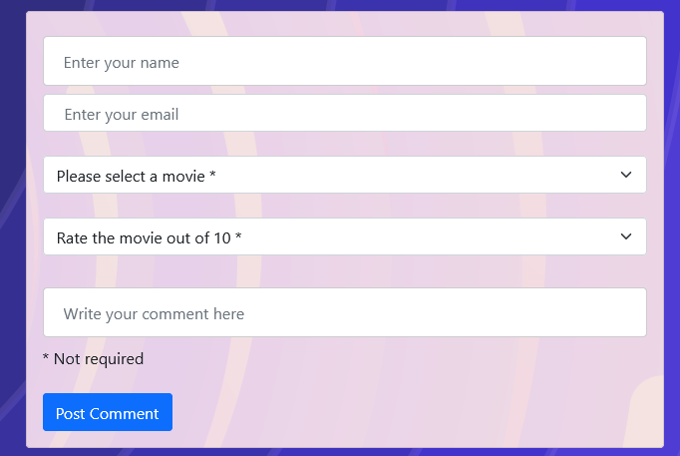

Discussion Forum

Slide 20




Big Thanks To the Team
Jamie Orr
Adil Akbarali
Kiera Hegarty
Conor Kelly

